Slide 1
Backdoor Removal Lab

Slide 2
Backdoor Removal Lab
Materials needed
Kali Linux Virtual Machine
Windows 7 Virtual Machine
Software tool used (from Kali Linux)
Metasploit Framework
Note: This lab will attempt to remove a backdoor session that is already open

Slide 3
Objectives Covered
Security+ Objectives (SY0-501)
Objective 1.1 – Given a scenario, analyze indicators of compromise and determine the type of malware
Backdoor
DHS CAE Units
CTH – Describe different types of attacks and their characteristics

Slide 4
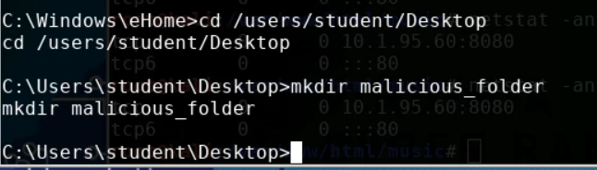
What is a Backdoor Attack?
A backdoor is when a malicious user gains privileged access to the system by circumventing normal authentication processes.
In this lab, you locate and remove a backdoor session.
It is recommended to have a reverse_http backdoor session for this lab
Here a Linux machine is controlling a Windows machine via a backdoor

Slide 5
The Backdoor Removal Lab
Open backdoor session
Quickly Shut Down Session
Verify the Closed Session
Re-Open Backdoor Session
Migrate the Session
Locate the Backdoor
Migrate the Session (Again)
Locate the Backdoor (Again)
Shut Down the Session
Verify the Closed Session

Slide 6
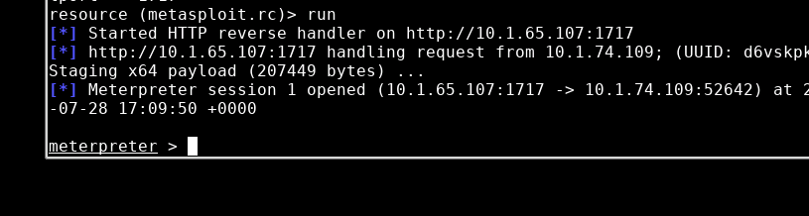
Open Backdoor Session
Make sure to have a backdoor session open
Kali Linux machine is controlling the backdoor
Windows 7 machine is being controlled
You can use Backdoor Trojan 1 or 2 Lab to help open a backdoor session
Open backdoor session

Slide 7
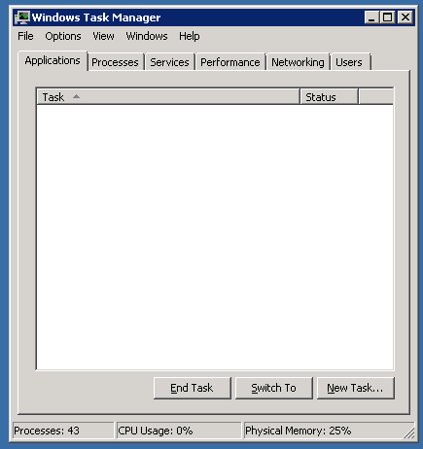
Quickly Shut Down Session
In Windows, the user knows it just opened the trojan and suspects it might be dangerous.
In Windows, open the task manager.
Press the Windows Start button
Search for “Task Manager”
Open the “View running processes with Task Manager”
Windows 7 Task Manager

Slide 8
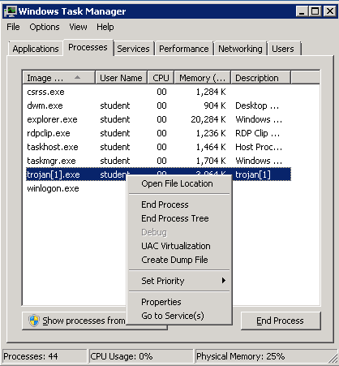
Quickly Shut Down Session
In the Task Manager, select the Processes tab
Search for the program name of the trojan
Right click on the trojan process
Select End Process
Select End process if a warning comes up as well
Select “End Process”

Slide 9
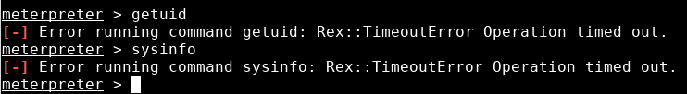
Verify the Closed Session
Go back to the Kali Machine
Try to run a command in the meterpreter session
Try getuid
Try sysinfo
You should notice that the commands do not work, the backdoor has been terminated
Please Note: This only works if the backdoor has not migrated onto another process. Typically, once the backdoor is opened, the malicious user will attempt to migrate the session away from the Trojan. The next activity searches for a migrated session and terminates it

Slide 10
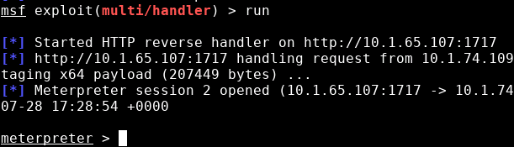
Re-Open Backdoor Session
Re-open the backdoor session.
In Kali, exit out of the shut down meterpreter session
exit
Re-start the handler
run
In Windows, re-open the trojan file
This should re-open the backdoor session
Backdoor session re-opened
Please Note: This next activity works best with a reverse_http backdoor session

Slide 11
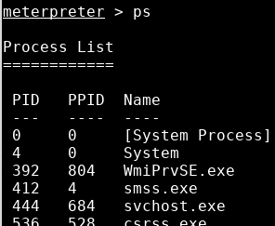
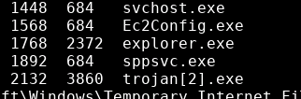

Migrate the Backdoor
Listing all the processes
In Kali, list all the processes
ps
Find the process named explorer.exe
Find the PID number of explorer.exe
It will be the first number
Migrate to explorer.exe
migrate <PID NUMBER>
explorer.exe PID
Migrating to the explorer.exe process

Slide 12
Locate the Backdoor
Finding the backdoor session in Windows is very difficult. Since the backdoor has to be talking back with Kali, you can monitor network activity to try and find the backdoor
In Windows, open task manager
Notice the trojan file is no longer in the processes list
Open the Resource Monitor
Select the Performance tab
Select the Resource Monitor… button

Slide 13
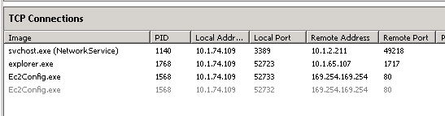
Locate the Backdoor
Monitor TCP activity
In the resource monitor app, click on the Network tab
Select the TCP Connections drop down menu
Find the explorer.exe in the image column
What remote address is explorer.exe talking to?
What remote port is explorer.exe talking to?
This should be your Kali IP Address and the port you assigned for the backdoor

Slide 14
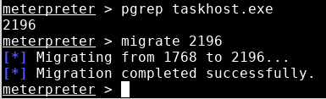
Migrate the Session (Again)
Actually see the backdoor migrate this time
In Kali, migrate to the taskhost.exe
pgrep taskhost.exe
migrate <TASKHOST.EXE_PID_NUMBER>
The backdoor session is now running on taskhost.exe
pgrep searches for a PID number of application named
Migrating backdoor to taskhost.exe

Slide 15
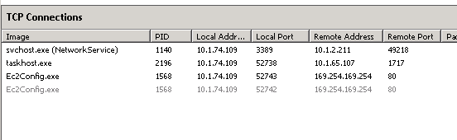
Locate the Backdoor (Again)
Go to Windows
In the Resource Monitor, you should see taskhost.exe
What IP Address is taskhost.exe talking to?
This should be your Kali IP Address and the port you assigned for the backdoor

Slide 16
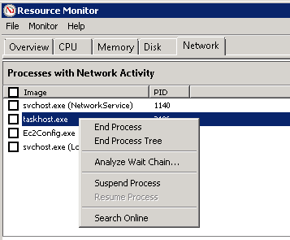
Shut Down Session
To terminate this backdoor session, you will need to terminate the taskhost.exe application
In the Resource Monitor, you should still be under the Network tab
Locate taskhost.exe in Processes with Network Activity
Right-click on taskhost.exe
Select End Process, this should terminate the backdoor session
End the taskhost.exe process

Slide 17
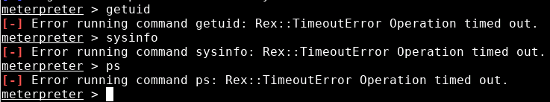
Verify the Closed Session
Go back to the Kali Machine
Try to run a command in the meterpreter session
Try getuid
Try sysinfo
Try ps
You should notice that the commands do not work, the backdoor has been terminated

